Slide 1

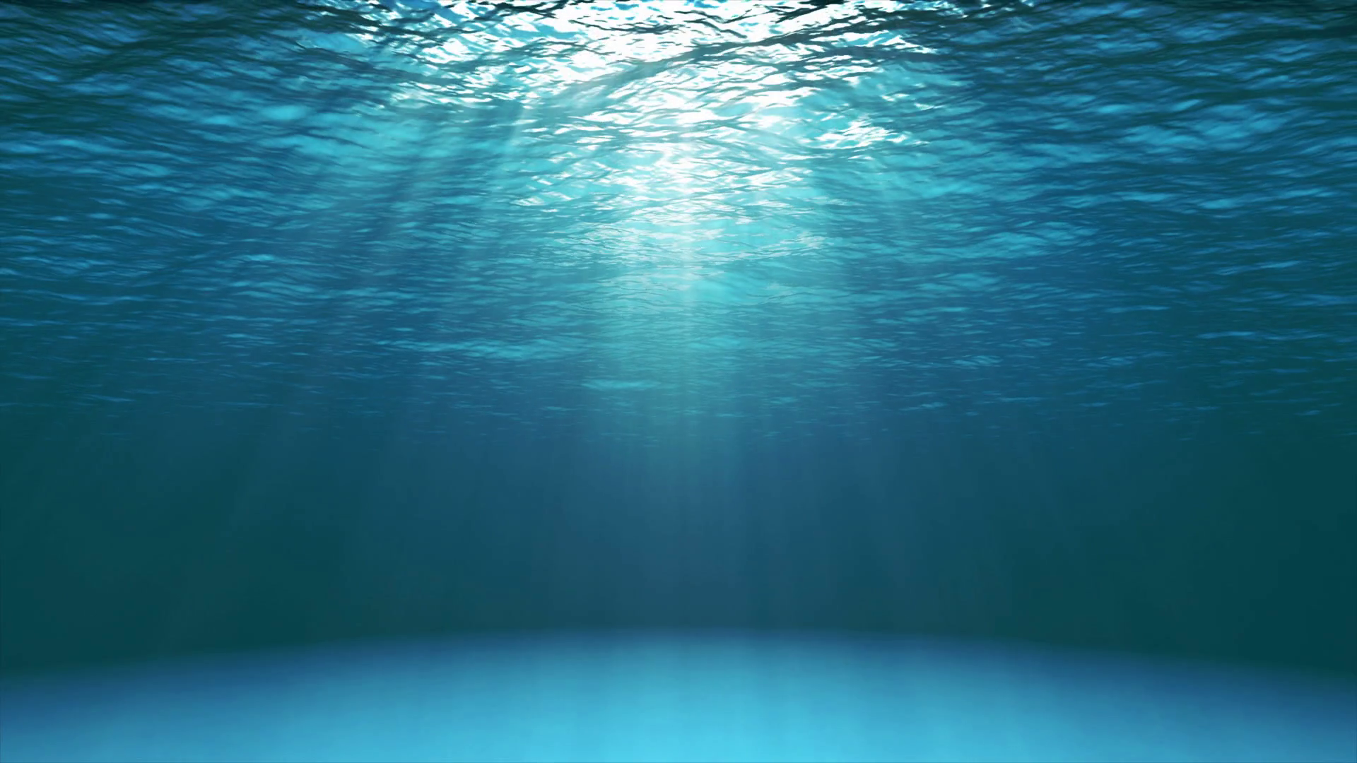
Elimination of skin stripes in underwater pictures
Miguel Jiménez Aparicio
Cristian Gómez Peces November 2019

Slide 2

Index
Project goals
Methodology
Algorithm
Results
Difficulties encountered
Further development
Conclusions

Slide 3

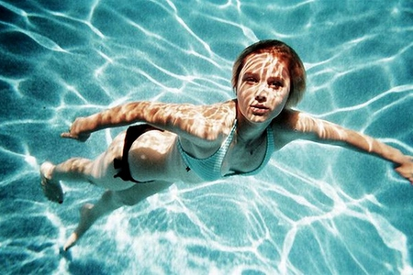
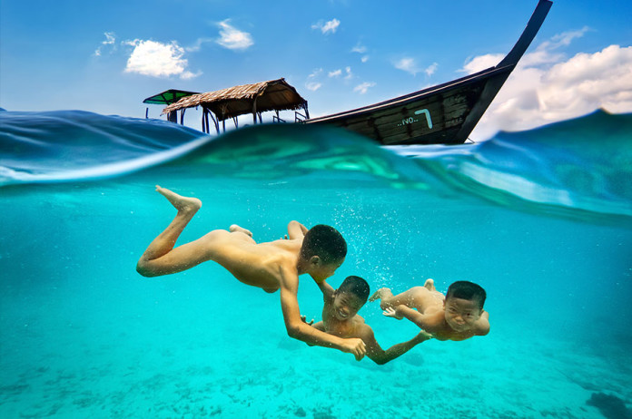
Project goals

Slide 4
Index
Project goals
Methodology
Algorithm
Results
Difficulties encountered
Further development
Conclusions

Slide 5
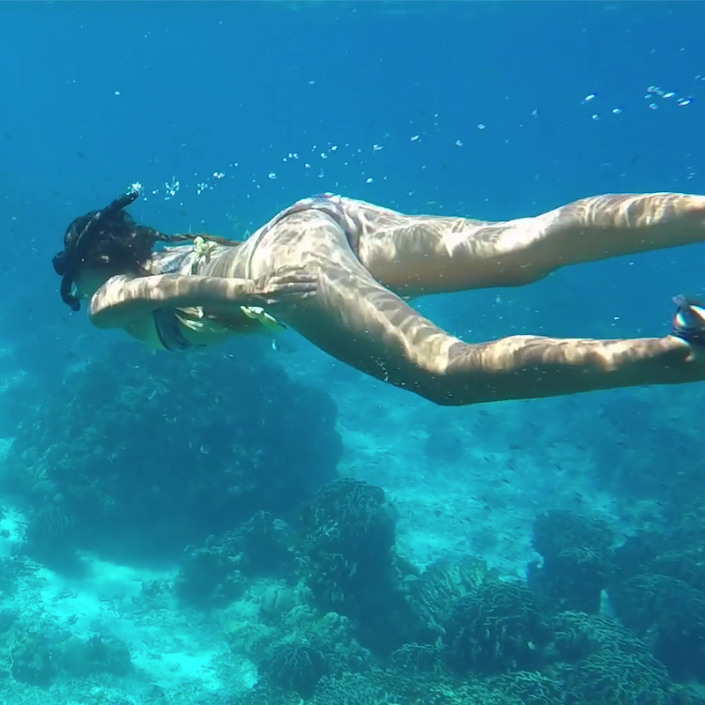

Methodology (I): Dataset used
1.
2.
Fix a picture where stripes are already present. Use subjective quality assesment to determine quality.
Edit a picture without stripes, apply our algorithm and compare with original. Use both subjetive and objective quality assesment.

Slide 6
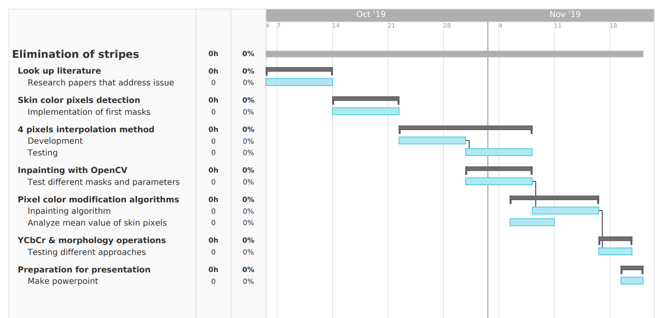
Methodology (II): Cronology

Slide 7
Index
Project goals
Methodology
Algorithm
Results
Difficulties encountered
Further development
Conclusions

Slide 8
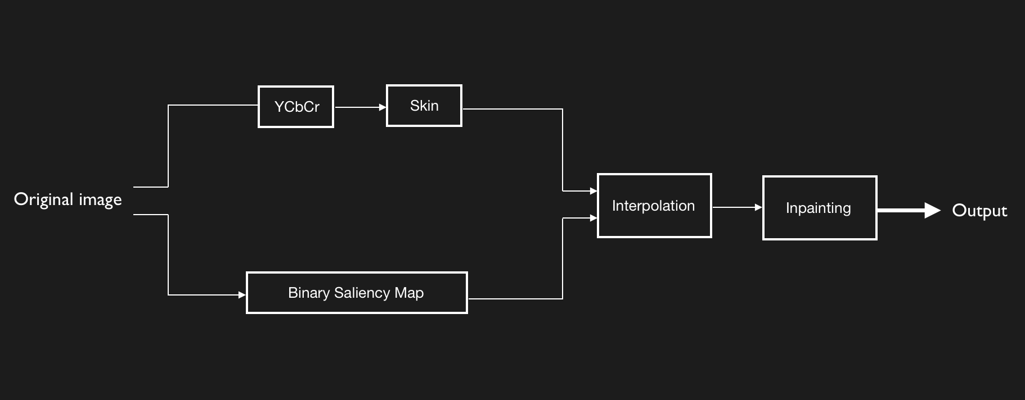
Block diagram

Slide 9
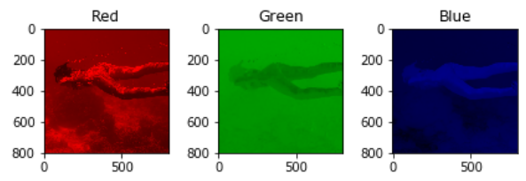
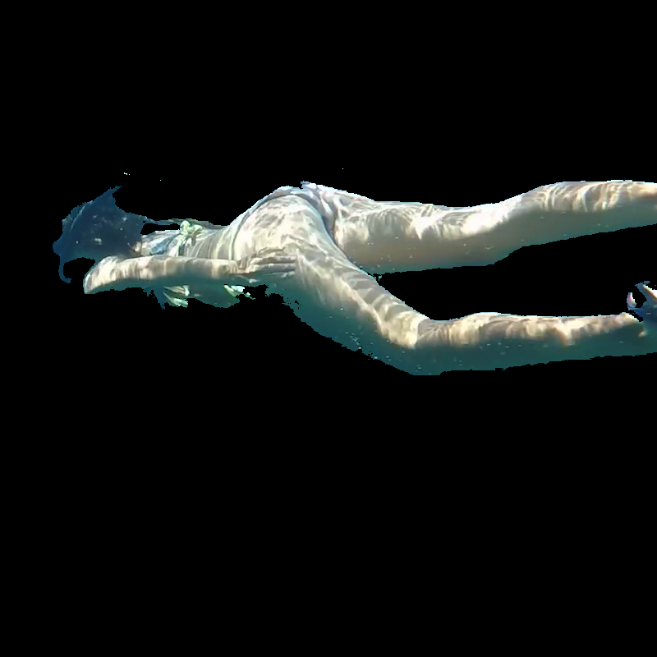
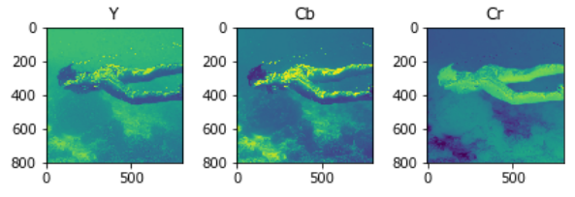
Algorithm (I): Dataset preparation

Slide 10
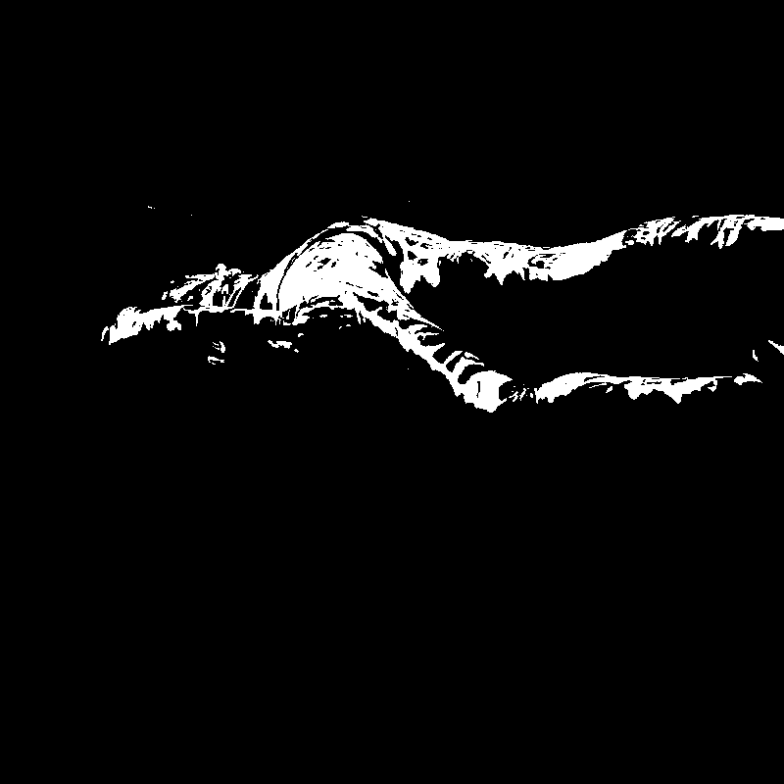
Algorithm (II): Saliency with binary map

Slide 11
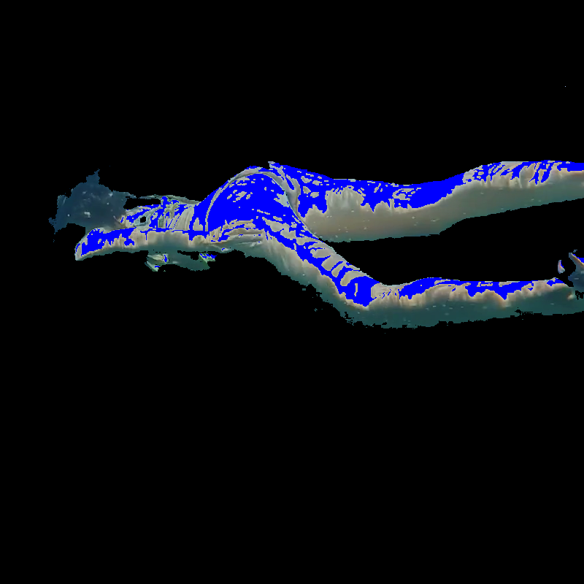
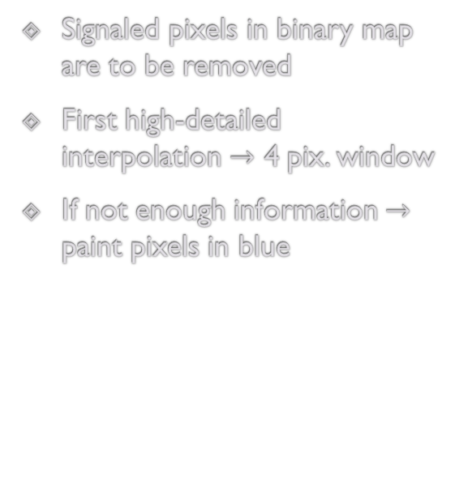
Algorithm (III): Interpolation
Signaled pixels in binary map are to be removed
First high-detailed interpolation $→$ 4 pix. window
If not enough information $→$ paint pixels in blue

Slide 12

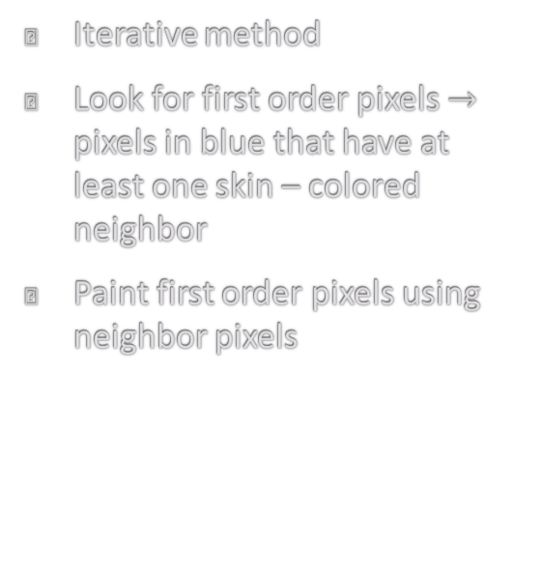
Algorithm (IV): Inpainting
Iterative method
Look for first order pixels $→$ pixels in blue that have at least one skin – colored neighbor
Paint first order pixels using neighbor pixels

Slide 13


Slide 14
Index
Project goals
Methodology
Algorithm
Results
Difficulties encountered
Further development
Conclusions

Slide 15
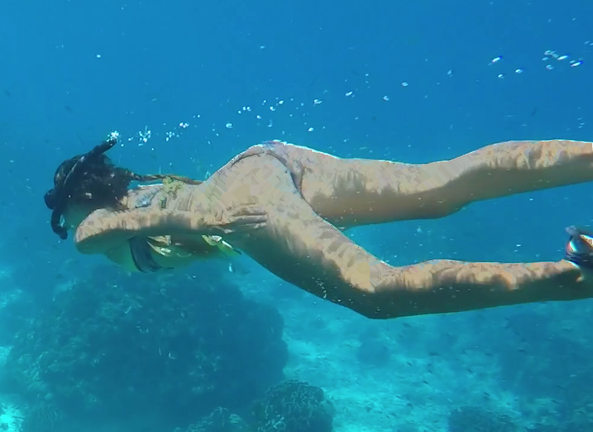
Results
BEFORE
AFTER

Slide 16
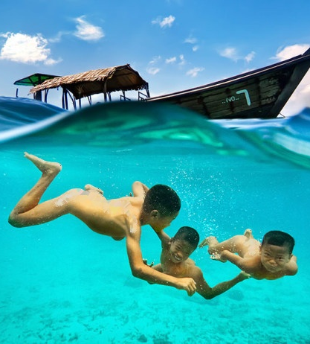
Results
ORIGINAL
MODIFIED
FIXED

Slide 17
Index
Project goals
Methodology
Algorithm
Results
Difficulties encountered
Further development
Conclusions

Slide 18
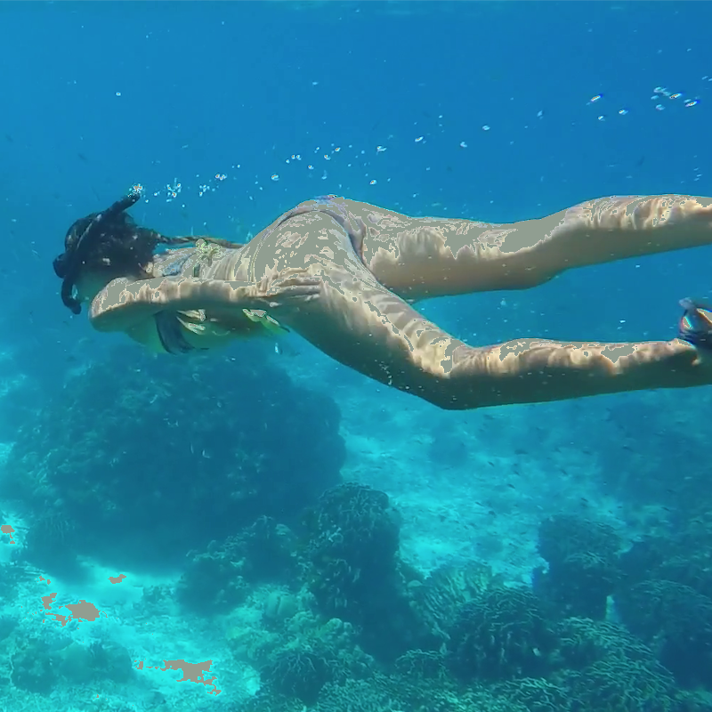


Difficulties encountered
After 4 px interpolation with mean skin color value
After Open CV inpainting
Before using YCbCr for skin detection

Slide 19
Index
Project goals
Methodology
Algorithm
Results
Difficulties encountered
Further development
Conclusions

Slide 20
Further development
Automatic parametric adjustment
Try algorithm with larger and more complex data set
Improve the algorithm in the inpainting phase to avoid the use of out-layers in the interpolation for extra bright areas
Include post-processing image enhancement in areas where the algorithm has little information available for the image inpainting

Slide 21
Index
Project goals
Methodology
Algorithm
Results
Difficulties encountered
Further development
Conclusions

Slide 22
Conclusion
In the woman picture, the proposed algorithm eliminates the stripes produced on the skin by water refraction
In the children picture, the added white stripes are almost completely removed
It was necessary to use inpainting as well, not only interpolation, in order to cover the undesired areas
Changing the image from RGB to YCbCr allows a more accurate skin detection

Slide 23

Questions?

